Slide 1
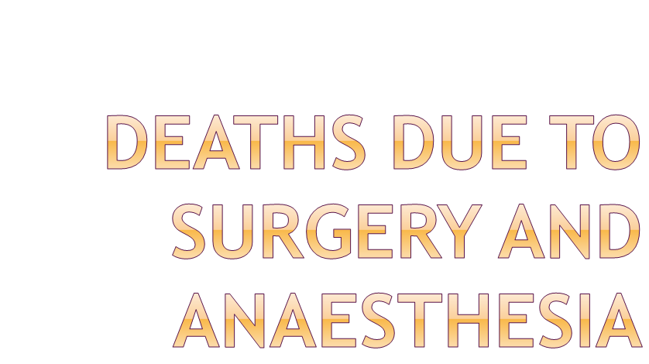

Slide 2


Slide 3

Objectives
At the end of this lecture the student should be able to understand the general principles involved in the investigation of a death following surgery and anaesthesia
Common reasons for a death following surgery and anesthesia and difficulties with such cases

Slide 4

Deaths during anaesthesia
During surgery
During an investigative procedure
Before recovery from anaesthesia
Unexplained deaths even after recovery
Results of a complication of anaesthesia, surgery or investigative procedure

Slide 5

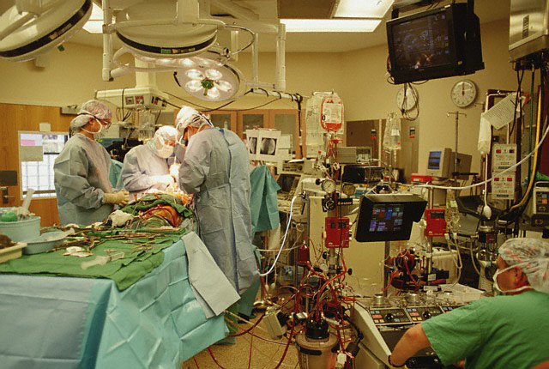
  Coronary bypass surgery
  Valve replacement surgery
Illness or injury which surgery was performed
  Coronary bypass surgery
  Valve replacement surgery

Slide 6
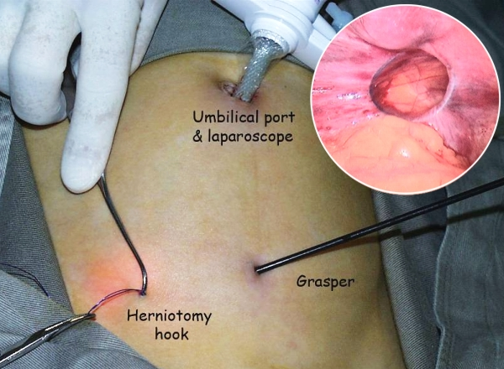
Known pre-existing disease aggravated during surgery or anaesthesia
  Re-infarction in a known patient with IHD during herniotomy

Slide 7

Unknown pre-existing natural illness aggravated by surgery or anaesthesia
  Patient with unknown IHD

Slide 8

Surgical causes
  Innocent surgical error
    Anatomical variation of blood vessels causing accidental cut leading to death
  Culpable surgical error
    While catheterizing heart chambers causing perforation, slipped ligatures

Slide 9

Hypersensitivity to anaesthetic drugs
Anaesthetic error
  wrong drug
  wrong doses
  faulty intubation
  faulty equipment
  failure to monitor the patient
  aspiration and choking
  undetected hypoxia

Slide 10
Anaesthetic machines with defects
  Faulty tubing
  Faulty meters
Empty cylinders or wrong gas in cylinders

Slide 11

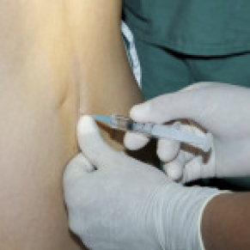
Deaths following local anaesthesia
  Over dose
  Inadvertent intravascular or intrathecal injections
  Fatal arrhythmias

Slide 12
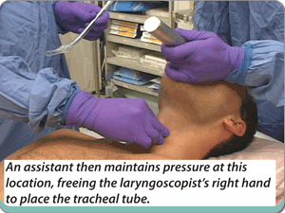
In lightly anaesthetized patient laryngoscopy or intubation causing vagal inhibition or coronary insufficiency

Slide 13
Malignant hyperthermia
  Operations done in theaters with malfunctioning air-conditions
  Precipitate by
    Succinyl choline
    Halothane

Slide 14

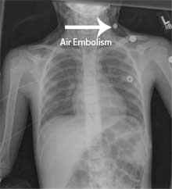
Air embolism

Slide 15

Inquest should be requested
Medico-legal autopsy
Autopsy by experienced forensic pathologist
All clinicians should be consulted

Slide 16

Clinicians or representatives should be present
Autopsy findings should be discussed with clinicians
Do all possible investigations
Include COD and autopsy findings in the report

Slide 17

The morphological findings
may be minimal or even absent
  Negative autopsy
  Non specific autopsy findings

Slide 18
The autopsy is difficult due to
surgical intervention and its sequelae

Slide 19
The dissection is difficult due to
  exudates
  sepsis
  adhesions
  haemorrhage
  oedema
  distortion of the normal anatomy

Slide 20
Postmortem changes complicate the appearance
Handling the tissue at autopsy tear the autolytic tissue

Slide 21
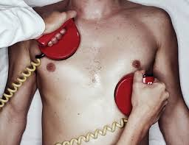
Presence of resuscitation artifacts
Non availability of pre operative samples
Non availability of pre-operative notes

Slide 22
Postmortem interference by removing surgical and anesthetic devices before checking their proper placement
Use of the anesthetic machine on another patient before the investigation

Slide 23

Autopsy is performed with minimal delay
Medical intervention should be left intact by medical and nursing staff
Clinical case notes, x’ rays and laboratory results are studied prior to autopsy
Polite and professional discussion with surgeon and anesthetist and invite to attend autopsy
Specimens retained for further investigations- toxicology, biochemistry, microbiology, histology

Slide 24

(1) History
  Verbal
    Relatives
    Eye witnesses - theatre staff
    Police officer
    Clinicians

Slide 25

  Documents
Pre-surgical notes by house officer and surgeon
Pre-anesthetic notes by anaesthetist
Pre surgical investigation – ECG, x-ray

Slide 26

Surgeons notes on the surgery and post operative period
Anesthetic notes on
  nature of anesthesia
  induction
  maintenance
  recovery

Slide 27
Nurses notes on the recovery period
Resuscitation notes
ETU/ ICU notes

Slide 28
(2) Visit to the scene
May be necessary in illegal operations like criminal abortions.
looking for evidence of haemorrhage

Slide 29
(3) Identification
-may be a problem in deaths following illegal operations
(4) Clothing – Blood stains

Slide 30
(5) Preliminary procedures –
a) Photography
b) X-rays - air-embolism,
-position of ET tube,
-surgical instruments in
cavities
c) Pre-autopsy blood samples to be preserved for therapeutic drug levels

Slide 31
(6) General external examination-
-pallor
-asphyxial features

Slide 32
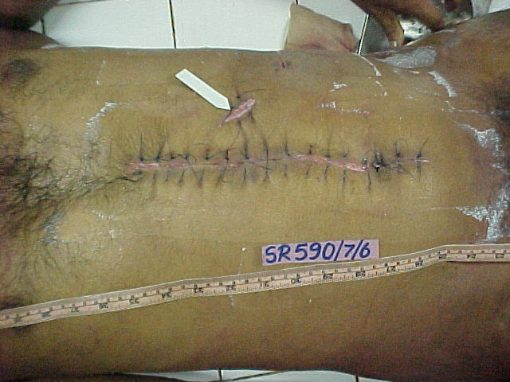
(7) Specific external examination –
(a) position of ET tube
(b) surgical incisions
(c) resuscitation injuries
(d) diathermy burns

Slide 33
  (e) electrocution injuries
(f) injuries for which anesthesia was given and surgery performed
(g) illness for which anesthesia was given or surgery performed

Slide 34
(8) Internal examination
  (a) Relevant to anesthesia –
    Oedema & congestion of oesophageal mucosa caused by false intubation

Slide 35
Distended stomach - (anesthetic gases)
Denture in trachea & bronchi
Laryngeal oedema
Evidence of anoxia / asphyxia
Brain oedema

Slide 36
      (b) Relevant to surgery
        -Nature of surgery
        -Slipped ligatures
        -Internal haemorrhage

Slide 37
      (b) Relevant to surgery
        -Pallor of organs
        -Evidence of surgical errors
        -Evidence of complications like pulmonary thrombo-embolism

Slide 38

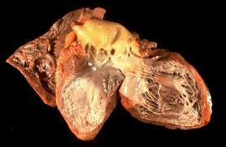
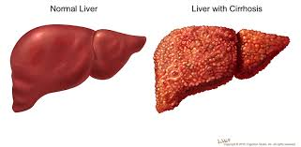
(c) Relevant to pre-existing natural diseases
Heart- infarctions, hypertrophy, valvular disease
Liver- cirrhosis, fatty liver
Brain- CVA, tumours
Lungs- COAD

Slide 39

(d) Nature & the extent of the disease deceased under went surgery under anesthesia
(e) Nature & extent of the internal injuries for which the deceased underwent surgery under anesthesia

Slide 40
(9) Lab investigations
    Obtain all the pre –operative samples
    Collect all vials, syringes, IV sets, blood transfusion set used on the patient before, during and after surgery

Slide 41
  (9) Lab investigations…
  -Post mortem toxicology
  -Histopathology
  -Seal machine and all gas cylinders used and sent to the Bio Medical Department of the ministry of health for a report

Slide 42
(10) Issue a report regarding the
  cause of death
  Important autopsy and lab findings
  Impact on natural disease which surgery was performed
  Impact of injury
  Impact of pre-existing natural disease

Slide 43

The result of the disease or injury for which the anaesthetic/operation being carried out
The result of some other disease or abnormality
The result of a surgical mishap
The result of anaesthetic mishap

Slide 44

Proof requires three elements to be established
Legal duty of care
Breach of duty by act of omission or commission
An established causal link between the irresponsible behaviour and damage to the patient
Note- The standard of care is defined as a standard of a reasonably skilled and experienced doctor working in a field judged by peer review

Slide 45

Reasons for anesthetic and surgical deaths
Medico-legal autopsy to be done
Proper investigation of death due to surgery and anesthesia

Slide 46

Forensic pathology and science, Vol II
Dr L.B. L. De Alwis
Knight’s Forensic Pathology 4th Edition
Text book of Clinical Forensic Medicine and Forensic Pathology by Professor Chandrasiri Niriella

Slide 47


